Slide 1
CS 2160
Chapter 2
Instructions: Language of the Computer

Slide 2
Instruction Set
§2.1 Introduction
The repertoire or “vocabulary” of instructions of a computer
Different computers have different instruction sets
But with many aspects in common
Early computers had very simple instruction sets
Many modern computers also have simple instruction sets
RISC (Reduced Instruction Set Computer)
62

Slide 3
The MIPS Instruction Set
Used as the example throughout the book
Stanford MIPS commercialized by MIPS Technologies (www.mips.com)
Large share of embedded core market
Applications in consumer electronics, network/storage equipment, cameras, printers, …
Typical of many modern ISAs
See MIPS Reference Data tear-out card, and Appendixes B and E
64

Slide 4
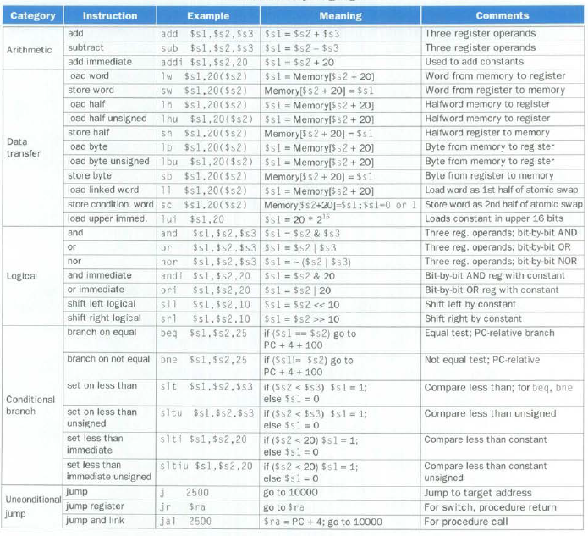
64

Slide 5
Register Designations
register | Assembly name | comment
R0 | $zero | Always 0
R1 | $at | Reserved for assembler
R2-r3 | $v0-$v1 | Stores results
R4-r7 | $a0-$a3 | Stores arguments
R8-r15 | $t0-$t7 | Temporaries, not saved
R16-r23 | $s0-$s7 | Contents saved for use later
R24-r25 | $t8-$t9 | More temporaries, not saved
R26-r27 | $k0-$k1 | Reserved by operating system
R28 | $gp | Global pointer
R29 | $sp | Stack pointer
R30 | $fp | Frame pointer
r31 | $ra | Return address
64

Slide 6
Arithmetic Example
C code:
f = (g + h) - (i + j);
MIPS assembly code:
add t0, g, h # temp t0 = g + h add t1, i, j # temp t1 = i + j sub f, t0, t1 # f = t0 - t1
Not MIPS (fixed 3 slides later)
65

Slide 7
Arithmetic Operations
Basic capability of every computer
Add and subtract, three operands
Two sources and one destination
add a, b, c # a gets b + c
All arithmetic operations have this form
Design Principle 1: Simplicity favors regularity
Regularity makes implementation simpler
Simplicity enables higher performance at lower cost
§2.2 Operations of the Computer Hardware
comment
Line of assembly code
65

Slide 8
Register Operands
Not a file on disk
Arithmetic instructions use register operands
MIPS has a 32 × 32-bit register “file” or registers
Use for frequently accessed data
Numbered 0 to 31
32-bit data called a “word”
Assembler names
$t0, $t1, …, $t9 for temporary values
$s0, $s1, …, $s7 for saved variables
Design Principle 2: Smaller is faster
c.f. main memory: millions of locations
§2.3 Operands of the Computer Hardware
67

Slide 9
Register Operand Example
C code:
f = (g + h) - (i + j);
f, …, j in $s0, …, $s4
Compiled MIPS code:
add $t0, $s1, $s2 add $t1, $s3, $s4 sub $s0, $t0, $t1
g
h
i
j
f
68

Slide 10
Memory Operands
Main memory used for composite data
Arrays, structures, dynamic data
To apply arithmetic operations
Load values from memory into registers
Store result from register to memory
Memory is byte addressed
Each address identifies an 8-bit byte
Words are aligned in memory
Address must be a multiple of 4
MIPS is “Bi” Endian
MARS models little Endian
Least significant byte at address of a word
c.f. Big Endian: most-significant byte at least address (Motorola)
69

Slide 11
Memory Operand Example 1
C code:
g = h + A[8];
g in $s1, h in $s2, base address of A in $s3
Compiled MIPS code:
Index 8 requires offset of 32
4 bytes per word
lw $t0, 32($s3) # load word add $s1, $s2, $t0
offset
base register
69

Slide 12
Memory Operand Example 2
C code:
A[12] = h + A[8];
h in $s2, base address of A in $s3
Compiled MIPS code:
Index 8 requires offset of 32
lw $t0, 32($s3) # load word add $t0, $s2, $t0 sw $t0, 48($s3) # store word
70

Slide 13
Registers vs. Memory
Registers are faster to access than memory
Operating on memory data requires loads and stores
More instructions to be executed
Compiler must use registers for variables as much as possible
Only spill to memory for less frequently used variables
Register optimization is important!
We’re ignoring cache

Slide 14
Immediate Operands
Constant data specified in an instruction
addi $s3, $s3, 4
No subtract immediate instruction
Just use a negative constant
addi $s2, $s1, -1
Design Principle 3: Make the common case fast
Small constants are common
Immediate operand avoids a load instruction
72

Slide 15
The Constant Zero
MIPS register 0 ($zero) is the constant 0
Cannot be overwritten
Useful for common operations
E.g., move between registers
add $t2, $s1, $zero
72

Slide 16
Unsigned Binary Integers
Given an n-bit number
§2.4 Signed and Unsigned Numbers
Range: 0 to +2^{n} – 1
Example
0000 0000 0000 0000 0000 0000 0000 1011₂ = 0 + … + 1×2³ + 0×2² +1×2¹ +1×2⁰ = 0 + … + 8 + 0 + 2 + 1 = 11₁₀
Using 32 bits
0 to +4,294,967,295
73

Slide 17
2s-Complement Signed Integers
It’s how you represent negative integers
What’s -1?
….111111111111
Add 1 to it, you get 0 (with an overflow)
General rule
Flip 1’s to 0’s and 0’s to 1’s
Add 1
Example: -4
Start with …00000100
…11111011 (flip bits
…11111100 (add 1)
74

Slide 18
Why is…
Why is 1111 1111 1111 1111 1111 1111 1111 1111 (32 1’s) equal to -1?
Because if you add 1 to it, you get 0 (!)

Slide 19
2s-Complement Signed Integers
Bit 31 is sign bit
1 for negative numbers
0 for non-negative numbers
2^{n} can’t be represented
Non-negative numbers have the same unsigned and 2s-complement representation
Some specific numbers
0: 0000 0000 … 0000
–1: 1111 1111 … 1111
Most-negative: 1000 0000 … 0000
Most-positive: 0111 1111 … 1111
77

Slide 20
Signed Negation
Complement and add 1
Complement means 1 → 0, 0 → 1
Example: negate +2
+2 = 0000 0000 … 0010₂
–2 = 1111 1111 … 1101₂ + 1 = 1111 1111 … 1110₂
So if you add 2, it becomes 0
77

Slide 21
Sign Extension
Representing a number using more bits
Preserve the numeric value
In MIPS instruction set
addi: extend immediate value
lb, lh: extend loaded byte/halfword
beq, bne: extend the displacement
Replicate the sign bit to the left
c.f. unsigned values: extend with 0s
Examples: 8-bit to 16-bit
+2: 0000 0010 => 0000 0000 0000 0010
–2: 1111 1110 => 1111 1111 1111 1110
78

Slide 22
Representing Instructions
Instructions are encoded in binary
Called machine code
MIPS instructions
Encoded as 32-bit instruction words
Small number of formats encoding operation code (opcode), register numbers, …
Regularity!
§2.5 Representing Instructions in the Computer
80

Slide 23
MIPS R-format Instructions
op
rs
rt
rd
shamt
funct
6 bits
5 bits
5 bits
5 bits
5 bits
6 bits
Instruction fields
op: operation code (opcode)
rs: first source register number
rt: second source register number
rd: destination register number
shamt: shift amount (00000 for now)
funct: function code (extends opcode)
2⁵=32
82

Slide 24
R-format Example
op
rs
rt
rd
shamt
funct
6 bits
5 bits
5 bits
5 bits
5 bits
6 bits
Six fields
add $t0, $s1, $s2
special
$s1
$s2
$t0
0
add
0
17
18
8
0
32
000000
10001
10010
01000
00000
100000
00000010001100100100000000100000₂ = 02324020₁₆
82

Slide 25
MIPS I-format Instructions
lw $t0, 800($t1)
op
rs
rt
constant or address
6 bits
5 bits
5 bits
16 bits
Four fields
Immediate arithmetic and load/store instructions
rt: destination or source register number
Constant: –2¹⁵ to +2¹⁵ – 1
Address: offset added to base address in rs
Design Principle 4: Good design demands good compromises
Different formats complicate decoding, but allow 32-bit instructions uniformly
Keep formats as similar as possible
83

Slide 26
I-Type Representations
lw $t0, 800($t1)
Op rt, i(rs)
op
rs
rt
constant or address
6 bits
5 bits
5 bits
16 bits
addi $t0, $t1, 8
Op rt, rs, i
83

Slide 27
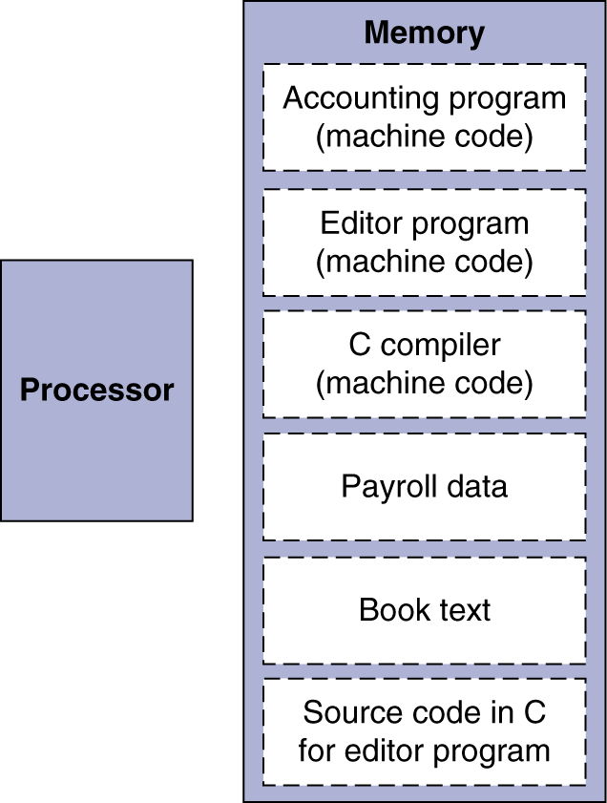
Stored Program Computers
The BIG Picture
Instructions represented in binary, just like data
Instructions and data stored in memory
Programs can operate on programs
e.g., compilers, linkers, …
Binary compatibility allows compiled programs to work on different computers
Standardized ISAs
86

Slide 28
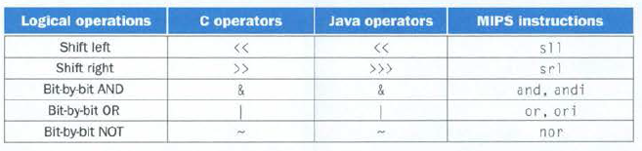

Logical Operators
sll $t2,$s0,4 # reg $t2 = reg $s0 << 4 bits
Binary: 000000 00000 10000 01010 00100 000000
0000 0000 0001 0000 0101 0001 0000 0000
Hex: 0x00105100
87

Slide 29
Shift Operations
op
rs
rt
rd
shamt
funct
6 bits
5 bits
5 bits
5 bits
5 bits
6 bits
shamt: how many positions to shift
Shift left logical
Shift left and fill with 0 bits
sll by i bits multiplies by 2^{i}
Shift right logical
Shift right and fill with 0 bits
srl by i bits divides by 2^{i} (unsigned only)
88

Slide 30
AND Operations
Useful to mask bits in a word
Select some bits, clear others to 0
and $t0, $t1, $t2
$t2
0000 0000 0000 0000 0000 1101 1100 0000
$t1
0000 0000 0000 0000 0011 1100 0000 0000
$t0
0000 0000 0000 0000 0000 1100 0000 0000
88

Slide 31
OR Operations
Useful to include bits in a word
Set some bits to 1, leave others unchanged
or $t0, $t1, $t2
$t2
0000 0000 0000 0000 0000 1101 1100 0000
$t1
0000 0000 0000 0000 0011 1100 0000 0000
$t0
0000 0000 0000 0000 0011 1101 1100 0000
88

Slide 32
NOT Operations
Useful to invert bits in a word
Change 0 to 1, and 1 to 0
MIPS has NOR 3-operand instruction
a NOR b == NOT ( a OR b )
nor $t0, $t1, $zero
Register 0: always read as zero
$t1
0000 0000 0000 0000 0011 1100 0000 0000
$t0
1111 1111 1111 1111 1100 0011 1111 1111
89

Slide 33
Conditional Operations
Branch to a labeled instruction if a condition is true
Otherwise, continue sequentially
beq rs, rt, L1
if (rs == rt) branch to instruction labeled L1;
bne rs, rt, L1
if (rs != rt) branch to instruction labeled L1;
j L1
unconditional jump to instruction labeled L1
§2.7 Instructions for Making Decisions
90

Slide 34
How do BEQ/BNE Instructions Work?
31
Instruction layout
0
op
rs
rt
Immediate Data
6 bits
5 bits
5 bits
16 bits
Operation code for BEQ or BNE in bits 26-31
Registers to compare in bits 21-25 and 16-20
Jump-to offset in bits 0-15
Signed integer (so ±32K)
Number of instructions, not address locations
Multiplied by 4
Added to current program counter
90

Slide 35
Note about the Program Counter
Shows the memory address from where the next instruction will be fetched
Therefore it is incremented as soon as an instruction is fetched
It does not point to the current instruction
Thus a branch offset of 0 does not reexecute the same instruction
Which is what happens when the branch fails

Slide 36
Program Counter Process
+4
PC
Instruction
Memory

Slide 37
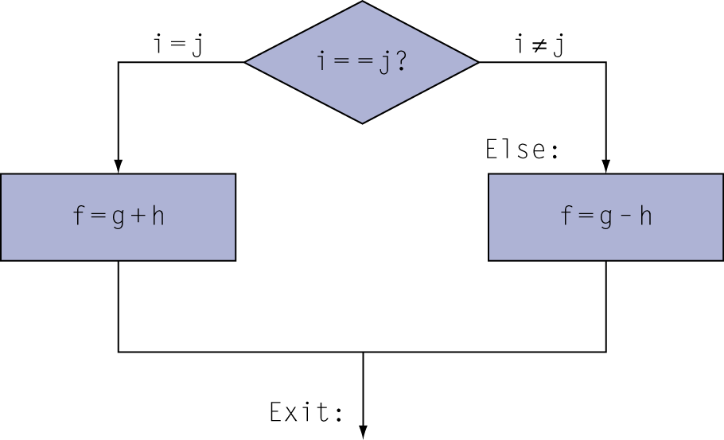
Compiling If Statements
C code:
if (i==j) f = g+h; else f = g-h;
f, g, h, I, j… in $s0, $s1, $s2, $s3, $s4
Compiled MIPS code:
bne $s3, $s4, Else add $s0, $s1, $s2 j Exit Else: sub $s0, $s1, $s2 Exit: …
Assembler calculates addresses
91

Slide 38
Compiling Loop Statements
C code:
while (save[i] == k) i += 1;
i in $s3, k in $s5, address of save in $s6
Compiled MIPS code:
Loop: sll $t1, $s3, 2 add $t1, $t1, $s6 lw $t0, 0($t1) bne $t0, $s5, Exit addi $s3, $s3, 1 j Loop Exit: …
Multiplies i * 4
Location of save[i]
Increments i
92

Slide 39
Basic Blocks
A basic block is a sequence of instructions with
No embedded branches (except at end)
No branch targets (except at beginning)
A compiler identifies basic blocks for optimization
An advanced processor can accelerate execution of basic blocks
93

Slide 40
More Conditional Operations
Set result to 1 if a condition is true
Otherwise, set to 0
slt rd, rs, rt # set on less than
if (rs < rt) rd = 1; else rd = 0;
slti rt, rs, constant
if (rs < constant) rt = 1; else rt = 0;
Use in combination with beq, bne
slt $t0, $s1, $s2 # if ($s1 < $s2) bne $t0, $zero, L # branch to L
93

Slide 41
Branch Instruction Design
Why not blt, bge, etc?
Hardware for <, ≥, … slower than =, ≠
Combining with branch involves more work per instruction, requiring a slower clock
All instructions would take longer
beq and bne are the common case
This is a good design compromise
93

Slide 42
Signed vs. Unsigned
Signed comparison: slt, slti
Unsigned comparison: sltu, sltui
Example
$s0 = 1111 1111 1111 1111 1111 1111 1111 1111
$s1 = 0000 0000 0000 0000 0000 0000 0000 0001
slt $t0, $s0, $s1 # signed
–1 < +1 ⇒ $t0 = 1
sltu $t0, $s0, $s1 # unsigned
+4,294,967,295 > +1 ⇒ $t0 = 0
94

Slide 43
Clever Use of SLTU
$t2 is the upper bound of an array
$s1 is the index into the array
Want to branch if $s1 is negative or $s1 > $t2
Sltu $t0, $s1, $t2
Beq $t0, $0, IndexOutOfBounds
$t0 is set if $s1 is positive and less than $t2
But not if $s1 is negative because most significant bit is set and so $s1 > $t2
95

Slide 44
Procedure Calling
Steps required
Place parameters in $a registers
Transfer control to procedure
Acquire storage for procedure
Perform procedure’s operations
Place result in $v registers for caller
Return to place of call
§2.8 Supporting Procedures in Computer Hardware
jal MyPRoc
addi $sp, $sp, -n
jr $ra
96

Slide 45
Register Usage
$a0 – $a3: arguments (reg’s 4 – 7)
$v0, $v1: result values (reg’s 2 and 3)
$t0 – $t9: temporaries
Can be overwritten by callee
$s0 – $s7: saved
Must be saved/restored by callee
$gp: global pointer for static data (reg 28)
$sp: stack pointer (reg 29)
$fp: frame pointer (reg 30)
$ra: return address (reg 31)
97

Slide 46
Procedure Call Instructions
Procedure call: jump and link
jal ProcedureLabel
Address of following instruction (PC) put in $ra
Jumps to target address
Procedure return: jump register
jr $ra
Copies $ra to program counter
Can also be used for computed jumps
e.g., for case/switch statements
95

Slide 47
Important Vocabulary
Caller: code executing the jal
Callee: destination of jal and calling jr $ra
Program Counter: $pc
Stack: memory located below stack pointer
Stack pointer: $sp
Push: decrement $sp, store word there
Pop: load word from $sp, increment $sp
98

Slide 48
Leaf Procedure Example
A procedure that doesn’t call another procedure
C code:
int leaf_example (int g, h, i, j) { int f; f = (g + h) - (i + j); return f; }
Arguments g, …, j in $a0, …, $a3
f in $s0 (hence, need to save $s0 on stack)
Result in $v0
98

Slide 49
Leaf Procedure Example
MIPS code:
leaf_example: addi $sp, $sp, -4 sw $s0, 0($sp) add $t0, $a0, $a1 add $t1, $a2, $a3 sub $s0, $t0, $t1 add $v0, $s0, $zero lw $s0, 0($sp) addi $sp, $sp, 4 jr $ra
Save $s0 on stack
Procedure body
Save return value
Restore $s0
Return
99

Slide 50
Non-Leaf Procedures
Procedures that may call other procedures
For nested call, caller needs to save on the stack:
Its return address (will be changed by jal)
Any arguments and temporaries needed after the call
Restore from the stack after the call

Slide 51
Non-Leaf Procedure Example
C code:
int fact (int n) { if (n < 1) return f; else return n * fact(n - 1); }
Argument n in $a0
Result in $v0

Slide 52
Non-Leaf Procedure Example
MIPS code:
fact: addi $sp, $sp, -8 # adjust stack for 2 items sw $ra, 4($sp) # save return address sw $a0, 0($sp) # save argument slti $t0, $a0, 1 # test for n < 1 beq $t0, $zero, L1 addi $v0, $zero, 1 # if so, result is 1 addi $sp, $sp, 8 # pop 2 items from stack jr $ra # and return L1: addi $a0, $a0, -1 # else decrement n jal fact # recursive call lw $a0, 0($sp) # restore original n lw $ra, 4($sp) # and return address addi $sp, $sp, 8 # pop 2 items from stack mul $v0, $a0, $v0 # multiply to get result jr $ra # and return
101

Slide 53
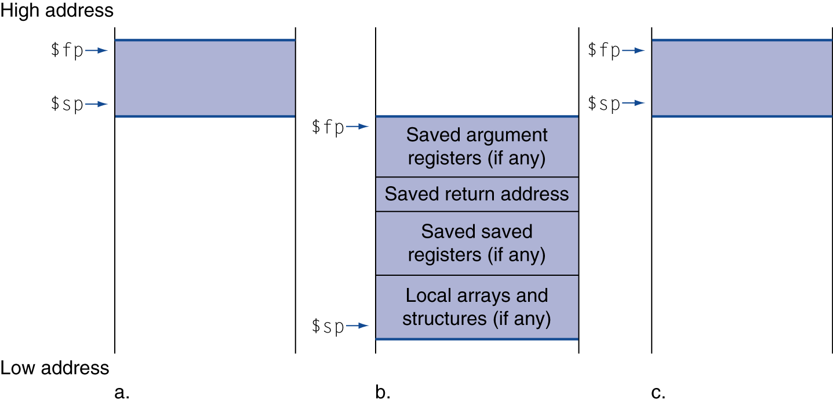
Local Data on the Stack
Before call
During call
After call
Local data allocated by callee
e.g., C automatic variables
Procedure frame (activation record)
Used by some compilers to manage stack storage
103

Slide 54
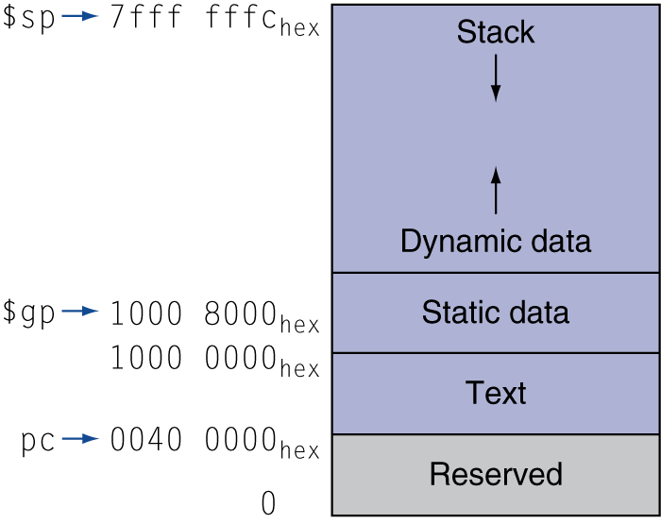
Memory Layout
Text: program code
Static data: global variables
e.g., static variables in C, constant arrays and strings
$gp initialized to address allowing ±offsets into this segment
Dynamic data: heap
E.g., malloc in C, new in Java
Stack: automatic storage
104

Slide 55
Character Data
§2.9 Communicating with People
Byte-encoded character sets
ASCII: 128 characters
95 graphic, 33 control
Latin-1: 256 characters
ASCII, +96 more graphic characters
Unicode: 32-bit character set
Used in Java, C++ wide characters, …
Most of the world’s alphabets, plus symbols
UTF-8, UTF-16: variable-length encodings
110

Slide 56
String Copy Example
C code (naïve):
Null-terminated string
void strcpy (char x[], char y[]) { int i; i = 0; while ((x[i]=y[i])!='\0') i += 1; }
Addresses of x, y in $a0, $a1
i in $s0
108

Slide 57
Byte/Halfword Operations
Could use bitwise operations
MIPS byte/halfword load/store
String processing is a common case
lb rt, offset(rs) lh rt, offset(rs)
Sign extend to 32 bits in rt
lbu rt, offset(rs) lhu rt, offset(rs)
Zero extend to 32 bits in rt
sb rt, offset(rs) sh rt, offset(rs)
Store just rightmost byte/halfword
110

Slide 58
String Copy MIPS Code
MIPS code:
strcpy: addi $sp, $sp, -4 # adjust stack for 1 item sw $s0, 0($sp) # save $s0 add $s0, $zero, $zero # i = 0 L1: add $t1, $s0, $a1 # addr of y[i] in $t1 lbu $t2, 0($t1) # $t2 = y[i] add $t3, $s0, $a0 # addr of x[i] in $t3 sb $t2, 0($t3) # x[i] = y[i] beq $t2, $zero, L2 # exit loop if y[i] == 0 addi $s0, $s0, 1 # i = i + 1 j L1 # next iteration of loop L2: lw $s0, 0($sp) # restore saved $s0 addi $sp, $sp, 4 # pop 1 item from stack jr $ra # and return
108

Slide 59
Arrays vs. Pointers
Array indexing involves
Multiplying index by element size
Adding to array base address
Pointers correspond directly to memory addresses
Can avoid indexing complexity
§2.14 Arrays versus Pointers
141

Slide 60
Example: Clearing an Array
clear1(int array[], int size) { int i; for (i = 0; i < size; i += 1) array[i] = 0; } | clear2(int *array, int size) { int *p; for (p = &array[0]; p < &array[size]; p = p + 1) *p = 0; }
move $t0,$zero # i = 0 loop1: sll $t1,$t0,2 # $t1 = i * 4 add $t2,$a0,$t1 # $t2 = # &array[i] sw $zero, 0($t2) # array[i] = 0 addi $t0,$t0,1 # i = i + 1 slt $t3,$t0,$a1 # $t3 = # (i < size) bne $t3,$zero,loop1 # if (…) # goto loop1 | move $t0,$a0 # p = & array[0] sll $t1,$a1,2 # $t1 = size * 4 add $t2,$a0,$t1 # $t2 = # &array[size] loop2: sw $zero,0($t0) # Memory[p] = 0 addi $t0,$t0,4 # p = p + 4 slt $t3,$t0,$t2 # $t3 = #(p<&array[size]) bne $t3,$zero,loop2 # if (…) # goto loop2
142

Slide 61
Comparison of Array vs. Ptr
Multiply “strength reduced” to shift
Array version requires shift to be inside loop
Part of index calculation for incremented i
c.f. incrementing pointer
Compiler can achieve same effect as manual use of pointers
Induction variable elimination
Better to make program clearer and safer
144

Slide 62
Java and C
Very different languages and philosophies
Java is object-oriented and interpreted
C is a lower-level language, 30 years older than Java, and extremely fast
There is a great demand for both in the current marketplace
Java tends to be web front-end oriented
C is back-end

Slide 63
ARM & MIPS Similarities
ARM: the most popular embedded core
Similar basic set of instructions to MIPS
§2.16 Real Stuff: ARM Instructions
 | ARM | MIPS
Date announced | 1985 | 1985
Instruction size | 32 bits | 32 bits
Address space | 32-bit flat | 32-bit flat
Data alignment | Aligned | Aligned
Data addressing modes | 9 | 3
Registers | 15 × 32-bit | 31 × 32-bit
Input/output | Memory mapped | Memory mapped
145

Slide 64
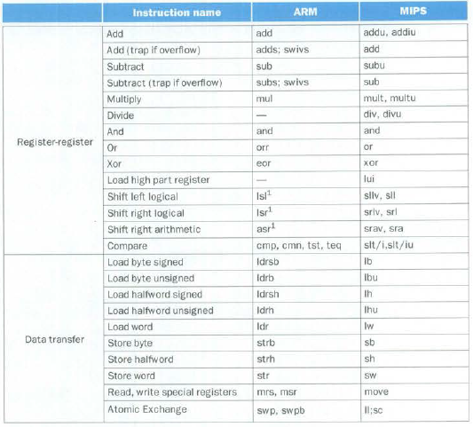
ARM/MIPS instructions
146

Slide 65
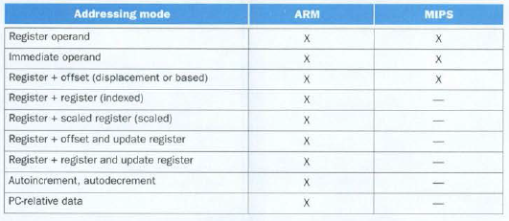
ARM/MIPS Addressing
147

Slide 66
Compare and Branch in ARM
Uses condition codes for result of an arithmetic/logical instruction
Negative, zero, carry, overflow
Compare instructions to set condition codes without keeping the result
Each instruction can be conditional
Top 4 bits of instruction word: condition value
Can avoid branches over single instructions
147

Slide 67
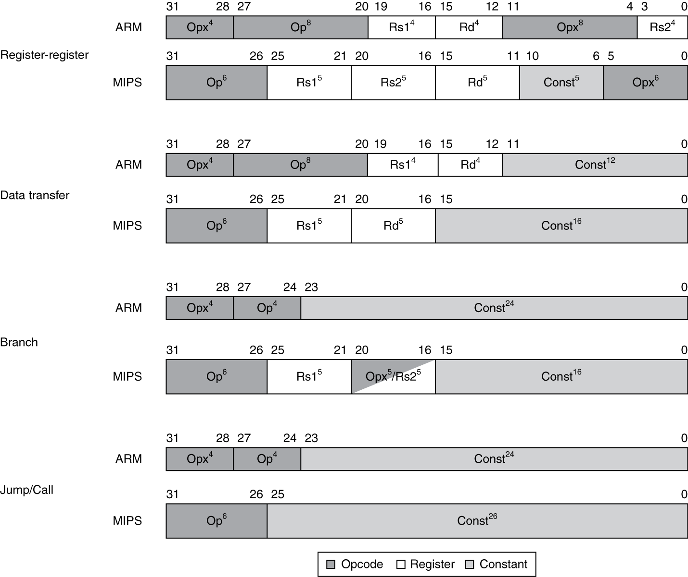
Instruction Encoding
148

Slide 68
ARM Immediate Field
8 bits rotated right in a 32-bit register
2 times these four
0x102 becomes 0x8000000
148

Slide 69
ARM LDM and STM
LDM = Load Multiple from stack
STM = Store Multiple to stack
16-bit mask indicates which registers
Options allow address pre- or post- increment or decrement
And register to contain beginning or ending address
149

Slide 70
The Intel x86 ISA
§2.17 Real Stuff: x86 Instructions
Evolution with backward compatibility
8080 (1974): 8-bit microprocessor
Accumulator, plus 3 index-register pairs
8086 (1978): 16-bit extension to 8080
Complex instruction set (CISC)
8087 (1980): floating-point coprocessor
Adds FP instructions and register stack
80286 (1982): 24-bit addresses, MMU
Segmented memory mapping and protection
80386 (1985): 32-bit extension (now IA-32)
Additional addressing modes and operations
Paged memory mapping as well as segments
149

Slide 71
The Intel x86 ISA
Further evolution…
i486 (1989): pipelined, on-chip caches and FPU
Compatible competitors: AMD, Cyrix, …
Pentium (1993): superscalar, 64-bit datapath
Later versions added MMX (Multi-Media eXtension) instructions
The infamous FDIV bug
Pentium Pro (1995), Pentium II (1997)
New microarchitecture (see Colwell, The Pentium Chronicles)
Pentium III (1999)
Added SSE (Streaming SIMD Extensions) and associated registers
Pentium 4 (2001)
New microarchitecture
Added SSE2 instructions
150

Slide 72
The Intel x86 ISA
And further…
AMD64 (2003): extended architecture to 64 bits
EM64T – Extended Memory 64 Technology (2004)
AMD64 adopted by Intel (with refinements)
Added SSE3 instructions
Intel Core (2006)
Added SSE4 instructions, virtual machine support
AMD64 (announced 2007): SSE5 instructions
Intel declined to follow, instead…
Advanced Vector Extension (announced 2008)
Longer SSE registers, more instructions
If Intel didn’t extend with compatibility, its competitors would!
Technical elegance ≠ market success
151

Slide 73
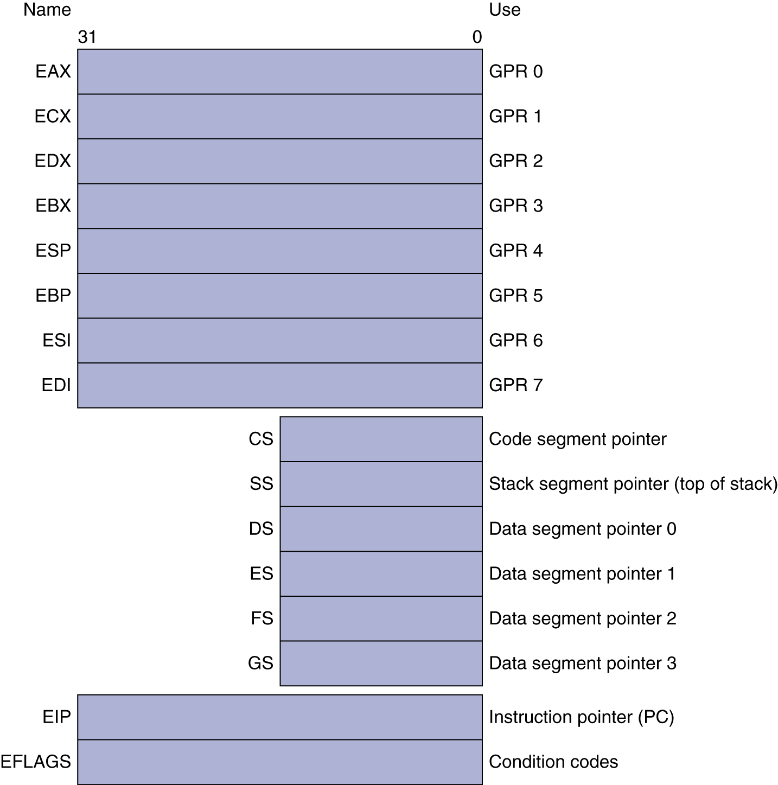
Basic x86 Registers
153

Slide 74
Basic x86 Addressing Modes
Two operands per instruction
Source/dest operand | Second source operand
Register | Register
Register | Immediate
Register | Memory
Memory | Register
Memory | Immediate
Memory addressing modes
Address in register
Address = R_{base} + displacement
Address = R_{base} + 2^{scale} × R_{index} (scale = 0, 1, 2, or 3)
Address = R_{base} + 2^{scale} × R_{index} + displacement
153

Slide 75
Example x86 Instructions
Instruction | Function
je name | If equal (condition code) {EIP=name}; EIP-128<=name<EIP+128
jmp name | EIP = name
call name | SP=SP-4; M[SP]=EIP+5; EIP=name;
movw EBX, [EDI+45] | EBX=M[EDI+45]
push esi | SP=SP-4; M[SP]=ESI;
pop edi | EDI=M[SP]; SP=SP+4;
add EAX, #C6765 | EAX=EAX+6765;
yest EDX, #42 | Set condition code (flags) with EDS and 42
movsl | M[EDI]=M[ESI]; EDI=EDI+4; ESI=ESI+4;
Want to learn how to do this?
155

Slide 76
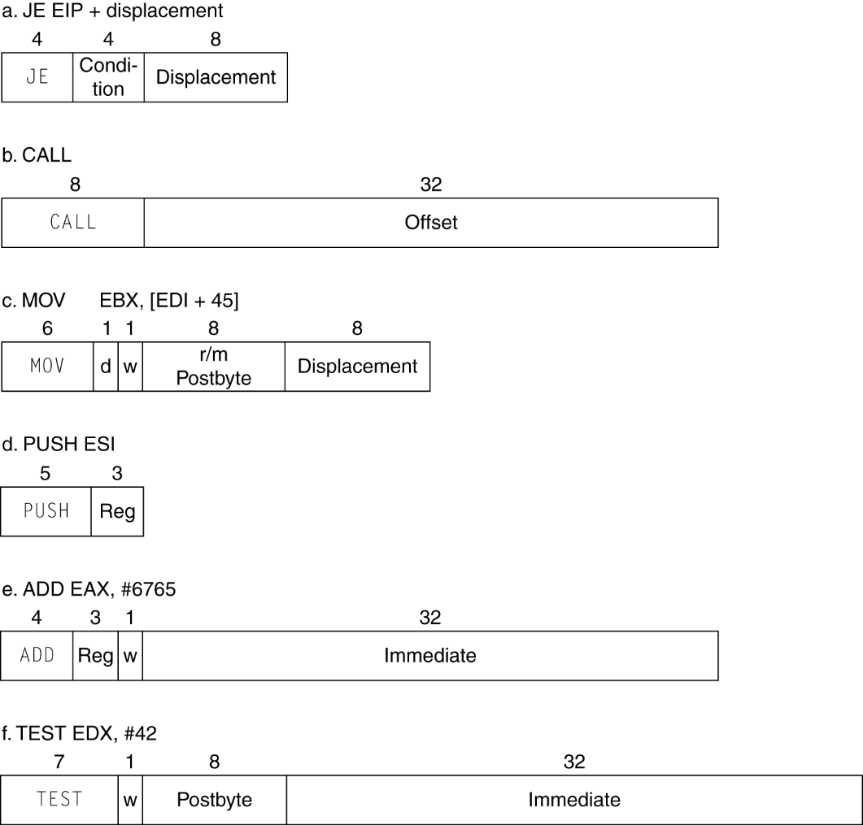
x86 Instruction Encoding
Variable length encoding
Postfix bytes specify addressing mode
Prefix bytes modify operation
Operand length, repetition, locking, …
157

Slide 77
Implementing IA-32
Complex instruction set makes implementation difficult
Hardware translates instructions to simpler microoperations
Simple instructions: 1–1
Complex instructions: 1–many
Microengine similar to RISC
Market share makes this economically viable
Comparable performance to RISC
Compilers avoid complex instructions
157

Slide 78
Conclusion about Intel
Intel had a 16-bit microprocessor two years before its competitors' more elegant architectures, such as the Motorola 68000, and this head start led to the selection of the 8086 as the CPU for the IBM PC. Intel engineers generally acknowledge that the x86 is more difficult to build than processors like ARMv7 and MIPS, but the large market meant in the PC Era that AMD and Intel could afford more resources to help overcome the added complexity. What the x86 lacks in style, it made up for in market size.
157

Slide 79
ARM v8
64-bit version of the v7
Re-engineered from the bottom up
Conditional execution field eliminated
32 general registers
DIV instruction
Includes a zero register
BNE and BEQ instructions added
158

Slide 80
Fallacies
§2.18 Fallacies and Pitfalls
Powerful instruction ⇒ higher performance
Fewer instructions required
But complex instructions are hard to implement
May slow down all instructions, including simple ones
Compilers are good at making fast code from simple instructions
Use assembly code for high performance
But modern compilers are better at dealing with modern processors
More lines of code ⇒ more errors and less productivity
159

Slide 81
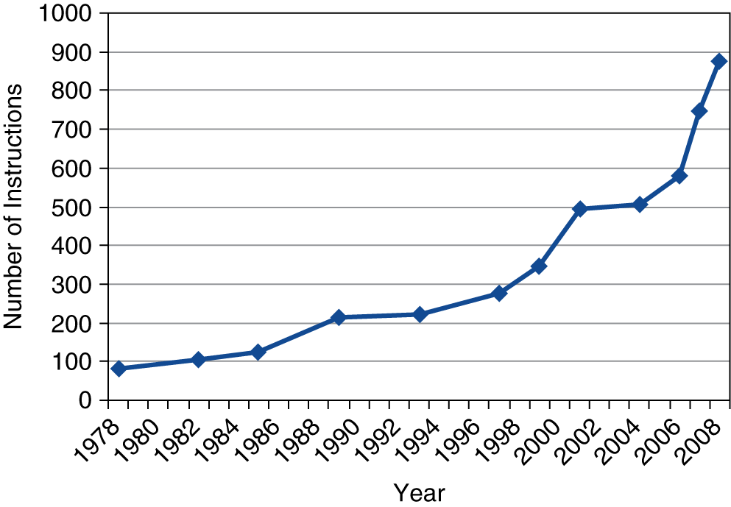
Fallacies
Backward compatibility ⇒ instruction set doesn’t change
But they do accumulate more instructions
x86 instruction set
161

